Slide 1
British Airways
Customer ratings analysis and insights
23-10-2023

Slide 2
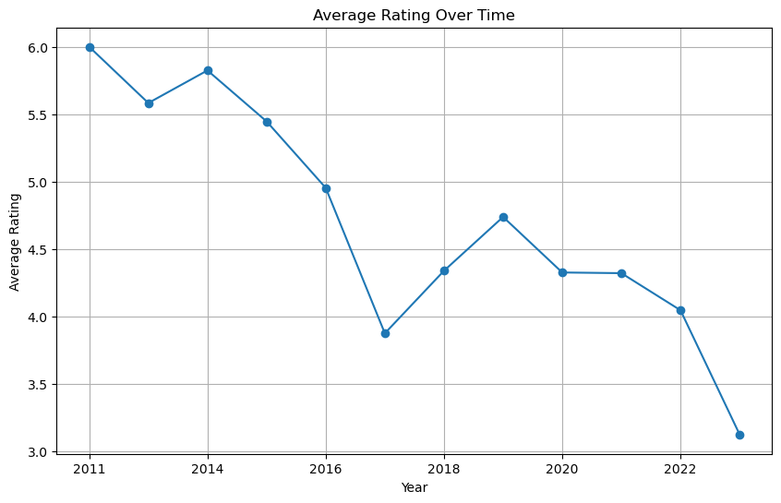

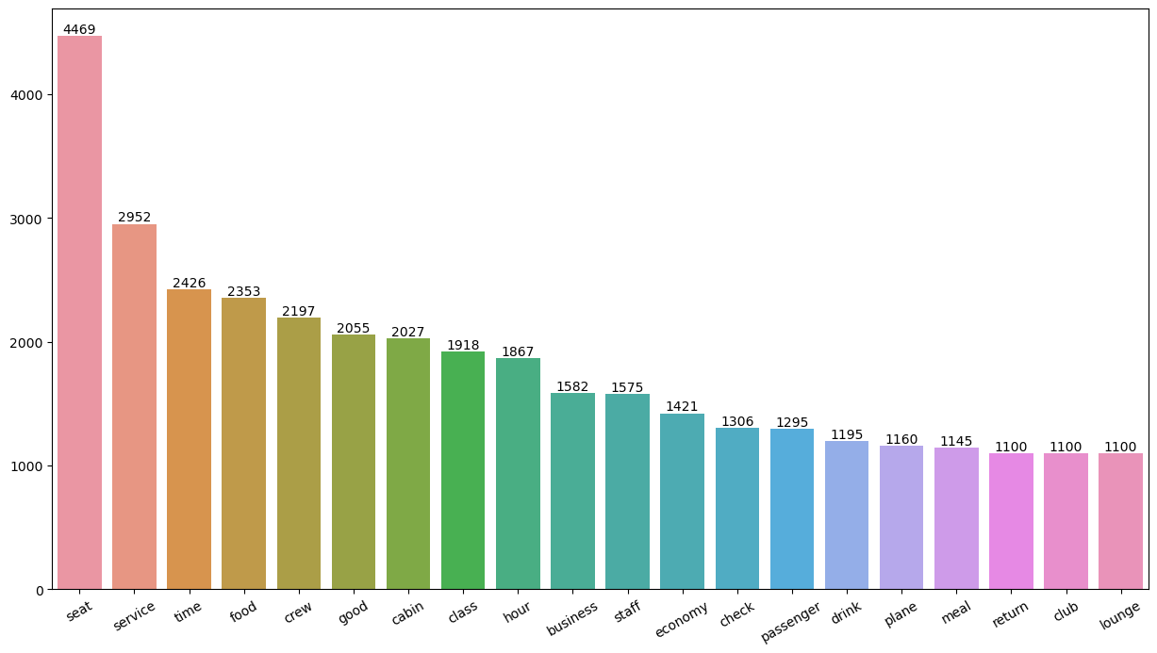
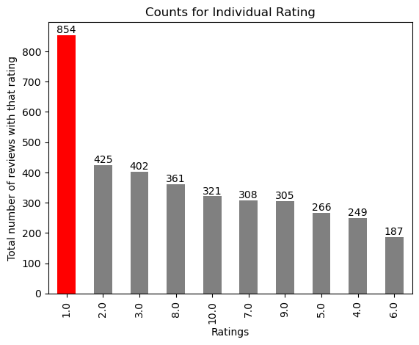
Key metrics
Average Overall Rating
4.72 /10
3678
Total Reviews Collected
AREAS OF FOCUS
Improving service and seats in the Economy class
Enhancing the in-flight entertainment experience
Addressing delays.
Improving customer service inquiries related to refunds and the refund process.
All customers expressed satisfaction with the cabin crew service and staff, as well as the general economy seats.
A significant number of travellers opted for the Business class.
However, in the Business class, customers appear to be seeking better value for their money.

